Slide 1
Sexual vs. Asexual Reproduction

Slide 2
Compare the results of uniform or diverse offspring from sexual or asexual reproduction
Uniform offspring
Diverse offspring
Sexual reproduction
Asexual reproduction

Slide 3
Sexual Reproduction
A type of reproduction in which the genetic materials from two different cells combine, producing an offspring
The cells that combine are called sex cells
Female – egg
Male – sperm
Fertilization: an egg cell and a sperm cell join together
A new cell is formed and is called a zygote

Slide 4
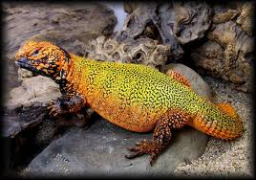
Advantages: Sexual Reproduction
Diverse offspring: genetic variation among offspring
Half of the DNA comes from mom
Half of the DNA comes from dad
Due to genetic variation, individuals within a population have slight differences
Plants – resist diseases
Traits can develop to resist harsh environments that allows an organism survive

Slide 5
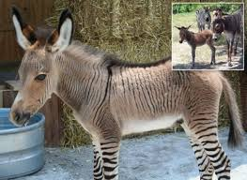
Advantages: Sexual Reproduction
Selective Breeding
Used to develop many types of plants and animals that have desirable traits
Agriculture/Farming: better plants, larger animals
Desirable pets

Slide 6
Disadvantages: Sexual Reproduction
Time and Energy
Organisms have to grow and develop until they are old enough to produce sex cells
Search and find a mate
Searching can expose individuals to predators, diseases, or harsh environmental conditions
Fertilization cannot take place during pregnancy, which can last as long as 2 years for some mammals.

Slide 7
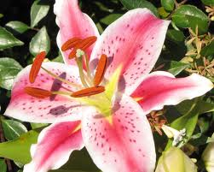
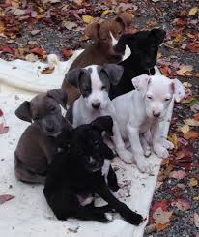
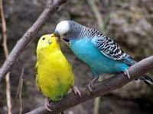
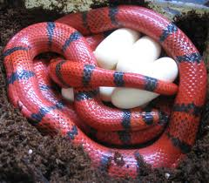
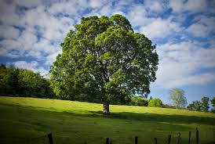
Examples: Sexual Reproduction

Slide 8
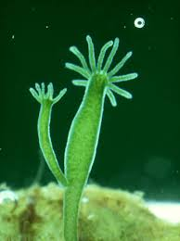
Asexual Reproduction
One parent: organism produces offspring without fertilization
Uniform offspring:
Because offspring inherit all of their DNA from one parent, they are genetically identical to each other and to their parent

Slide 9
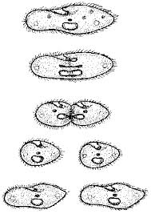
Fission: Asexual Reproduction
Fission: Cell division in prokaryotes that forms two genetically identical cells
DNA is copied
The cell begins to grow longer, pulling the two copies apart
The cell membrane pinches inward in the middle of the cell
Cell splits to form two new uniform, identical offspring
Examples: bacteria, Ecoli, pond critters

Slide 10
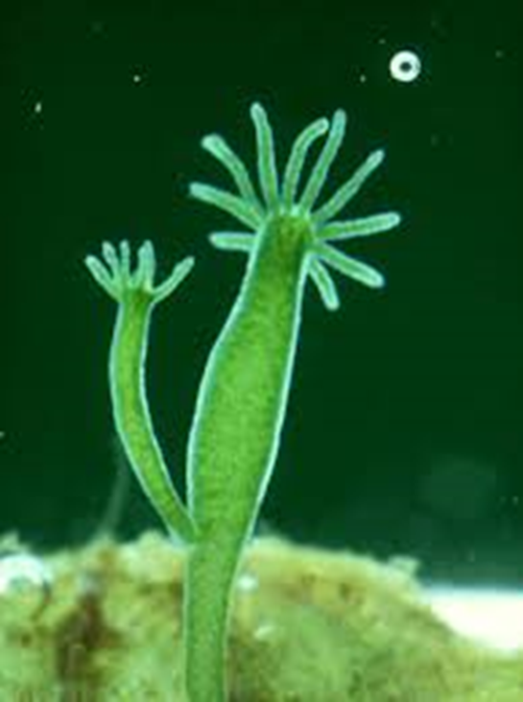
Budding: Asexual Reproduction
Budding: a new organism grows by mitosis and cell division on the body of its parent
The bud, or offspring is identical to the parent
The bud, when large enough, can break off of the parent and live on its own
Offspring may remain attached and form a colony
Examples: Yeast, Hydra, cactus

Slide 11
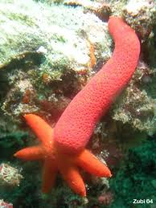
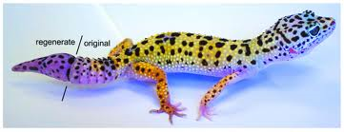
Regeneration: Asexual Reproduction
Regeneration: occurs when an offspring grows from a piece of its parent.
Producing new organisms: Sea Stars
Sea urchins, sea cucumber, sponges, and planarians
Producing new body parts: Gecko
Newts, tadpoles, crabs, hydra, and zebra fish

Slide 12
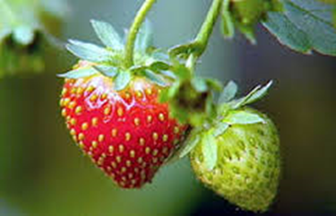
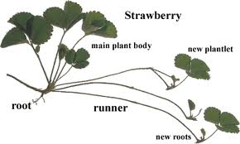
Vegetative Reproduction (Propagation): Asexual
Vegetative Propagation: uniform offspring grow from a part of a parent plant
Parent plants sends out runners
Where the runner touches the ground, roots can grow
A new plant is produced even if the runner is broken apart
Each new plant is uniform and identical to the parent.
Examples: strawberries, potatoes, ivy, crabgrass

Slide 13
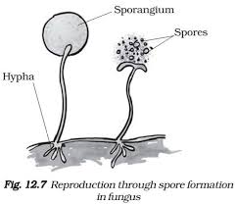
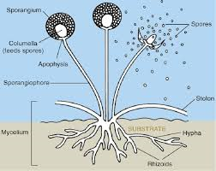
Spore Formation asexual reproduction
In this method of reproduction, the parent plant produces hundreds of tiny spores which can grow into new plants.
The spores are microscopic, tough and resistant which are round in shape and can grow into a new plant under suitable conditions
Examples: nonflowering plants, bacteria, fungi, and algae

Slide 14
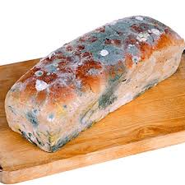
Advantages: Asexual Reproduction
Enables organisms to reproduce without a mate
No wasted time and energy
Enables some organisms to rapidly reproduce a large number of uniform offspring

Slide 15
Disadvantages: Asexual Reproduction
Because their offspring are identical, there is no genetic variation that can give an organism a better chance for survival
Example: If a weed killer can kill the parent, it will also kill the offspring
A whole species can be wiped out from a disease
Dangerous mutations in DNA – if the parent has the mutation in their DNA, the offspring will have it too.

Slide 16
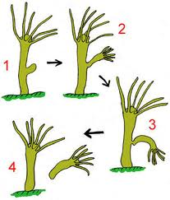
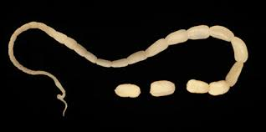
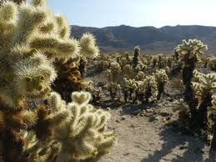
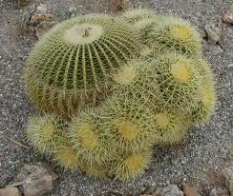
Examples: Asexual Reproduction

Slide 17
Activity:
Create a creature that reproduces asexually.
Draw the creature
Describe how the creature reproduces asexually
Describe 1 advantage of reproducing this way
Describe 1 disadvantage of reproducing this way
Name your creature
How the uniform offspring of your creature

