Slide 1
Human Impact

Slide 4
Human Impact on Water

Slide 5
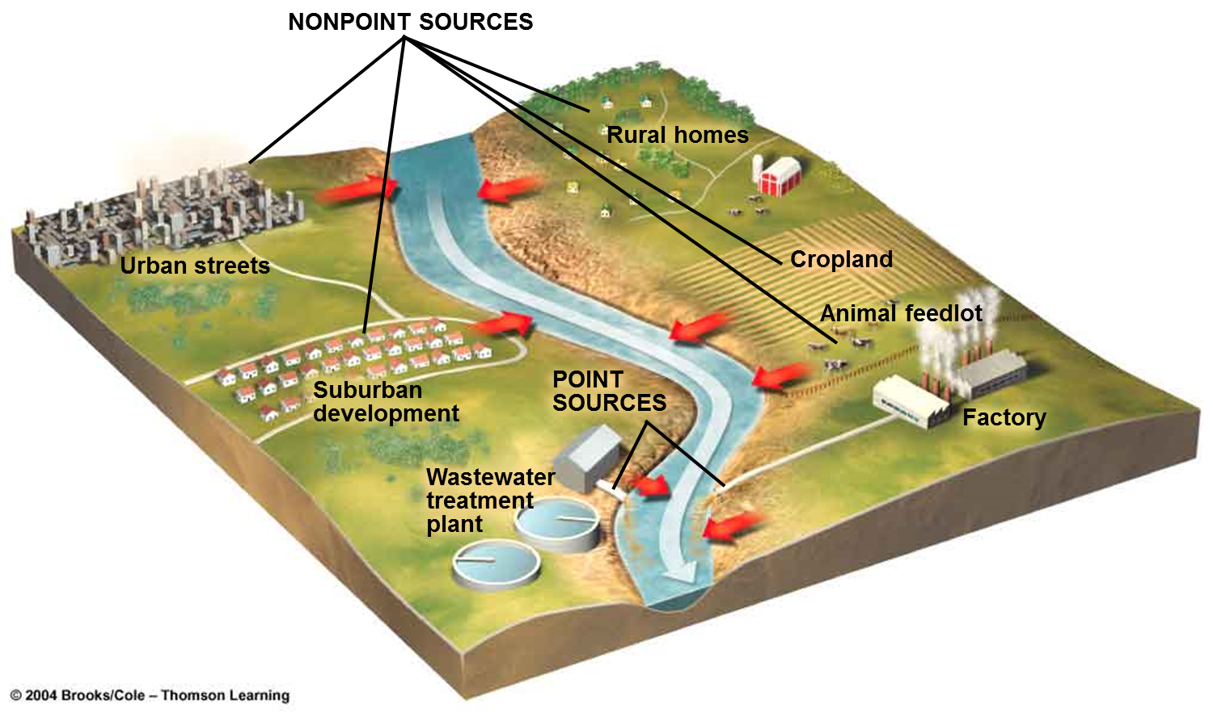
Point Source Vs Non-point source Pollution
Can trace back to the source ex. Factory
Many sources cant pin point the source

Slide 6
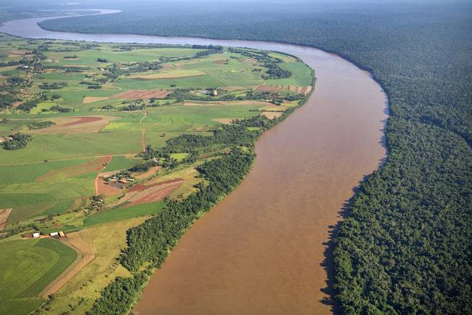
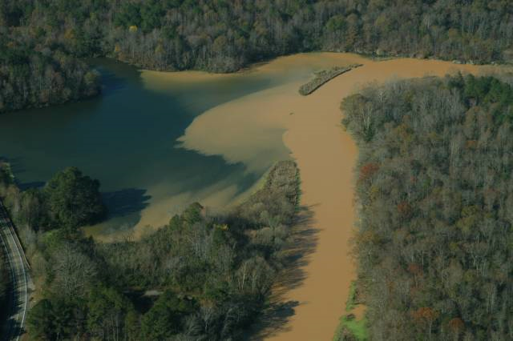
Examples of water pollution
Sediment- Makes water cloudy, blocks sunlight getting to plants (Turbidity- a measure of the cloudiness of water)

Slide 7
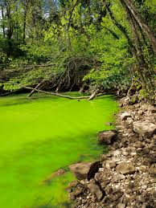
Water pollution
Sewage, industrial waste, oil, pesticides and fertilizers all pollute water.
Fertilizers and sewage can easily be washed into rivers, streams and lakes. The nutrients, phosphates and nitrates in these substances cause eutrophication.
Eutrophication is the accumulation of nutrients in water, which causes excessive algal growth. This leads to a reduction in oxygen levels and the death of aquatic life.

Slide 9
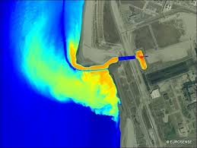
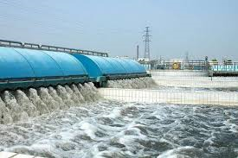
Water Pollution
Thermal pollution- heated water released from industrial factories can reduce oxygen available for organisms or change the temperature they need to survive.

Slide 10
Human Impact on Air

Slide 11
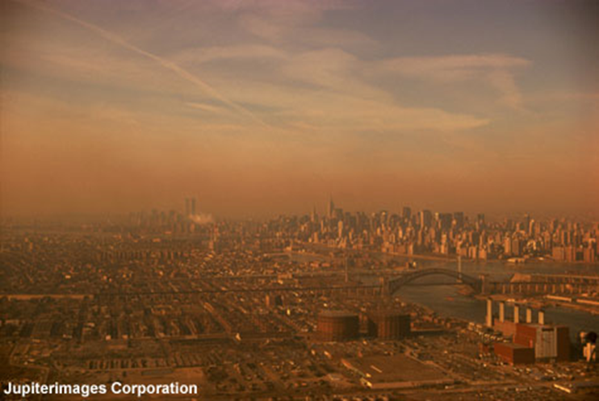
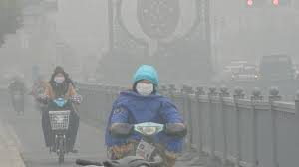
Air Pollution
Smog is a mixture of air pollutants and particulates that is sometimes found in the lower levels of the atmosphere. It has a distinctive brownish haze.
Smog can reach dangerous levels in built-up areas, causing irritation to the eyes and lungs.

Slide 12
Air Pollution- Acid Rain

Slide 13
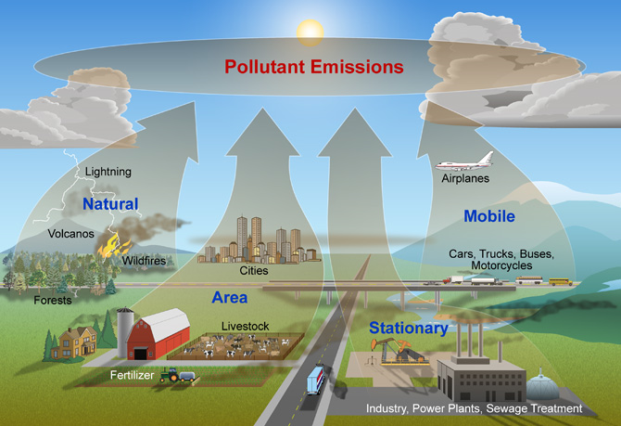
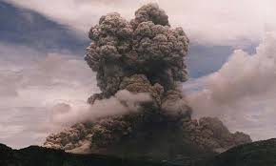
Air pollution
Natural Events- materials from ash, dust, and gases can cause health problems

Slide 14
Human Impact on LAND

Slide 15
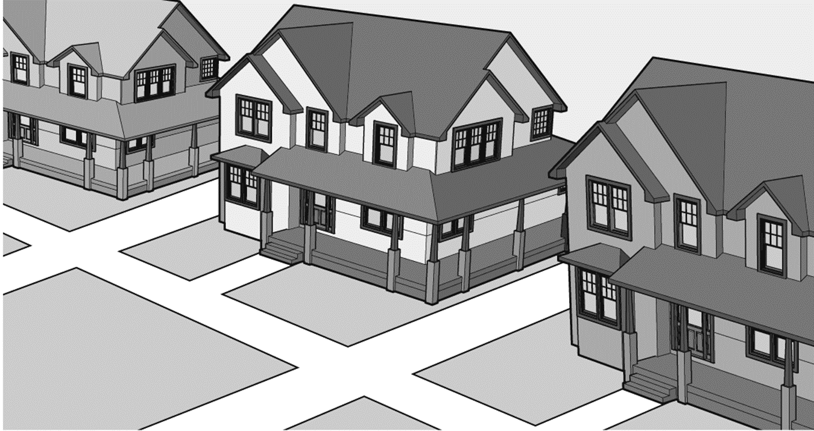
What type of land use is this?

Slide 16
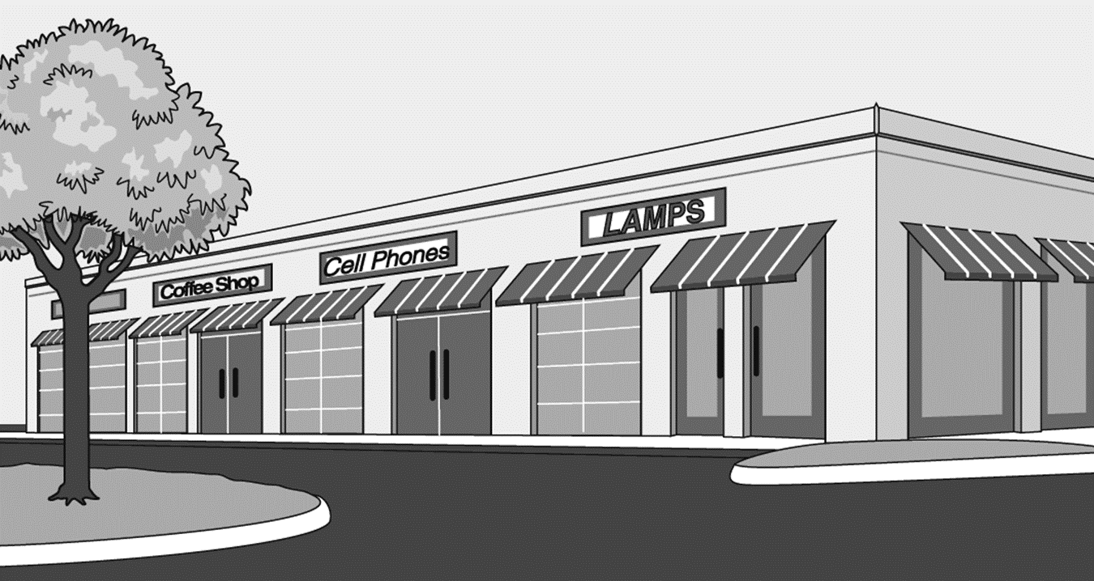
What type of land use is this?

Slide 17
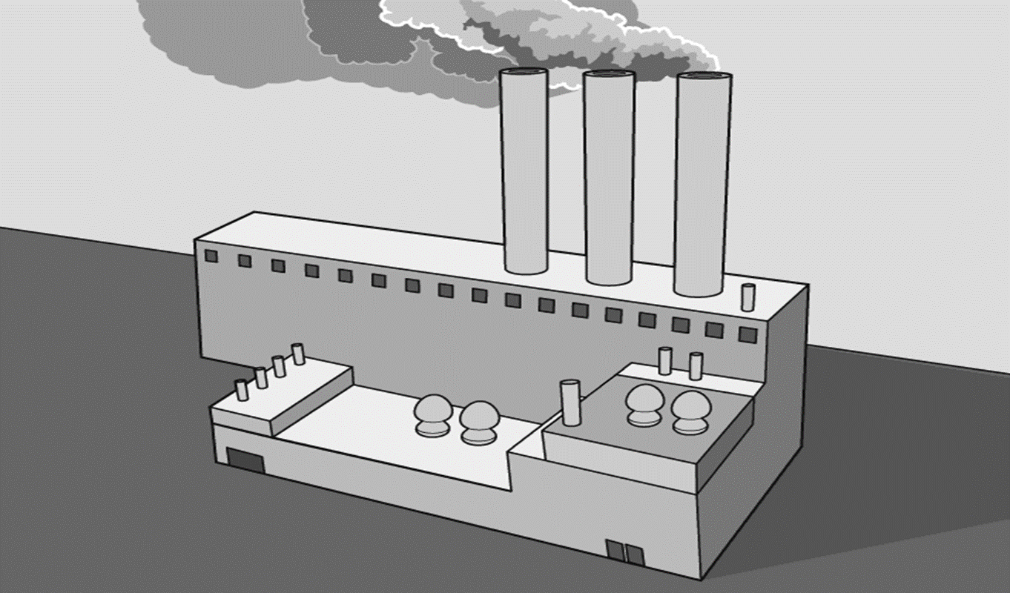
What type of land use is this?

Slide 18
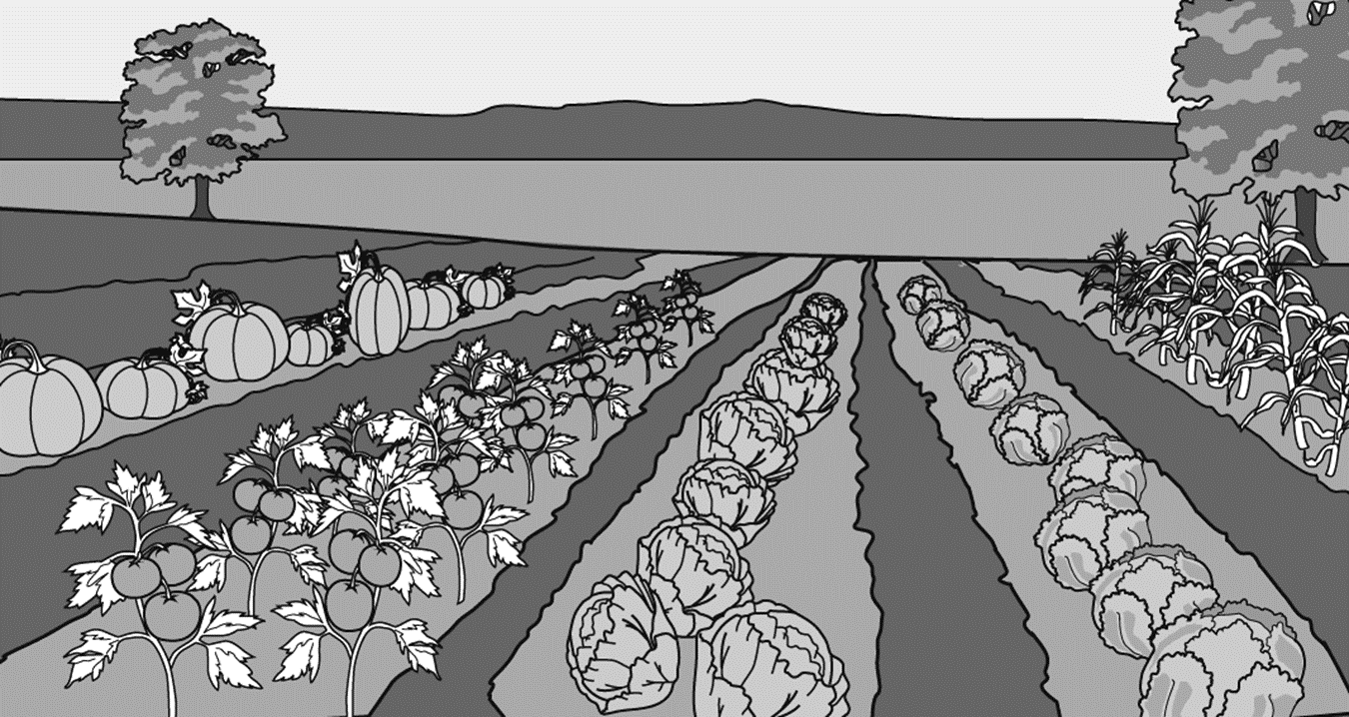
What type of land use is this?

Slide 19
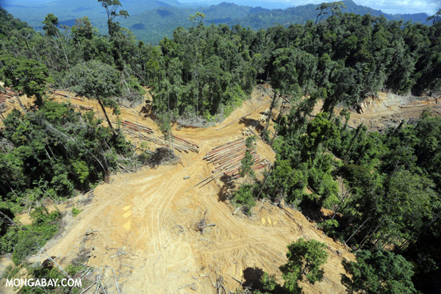
What is deforestation? is when humans remove or clear large areas of forest lands and related ecosystems for non-forest use (Textbook pg. 213)
Why do humans clear forest lands?
Effects of deforestation
Trees are cut down (deforestation) for many reasons including:
To be used, sold or exported as timber, wood or fuel (charcoal). This is called logging.
To be used for farming purposes (grazing fields for livestock, or large scale farming activities)
To make room for human settlement and urbanization (these include making space for shelter, industries and roads)
To make room for mining
Soil erosion destruction.
Water Cycle
Loss of Biodiversity
Climate Change

Slide 20
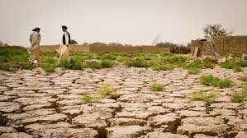
Desertification- the process by which land becomes more desert like and unable to support life
What Causes Desertification?
The Effects Of Desertification
Overgrazing
Urbanization
Poor farming methods
Soil becomes less usable
vegetation is Lacked or Damaged
Food Loss

Slide 21
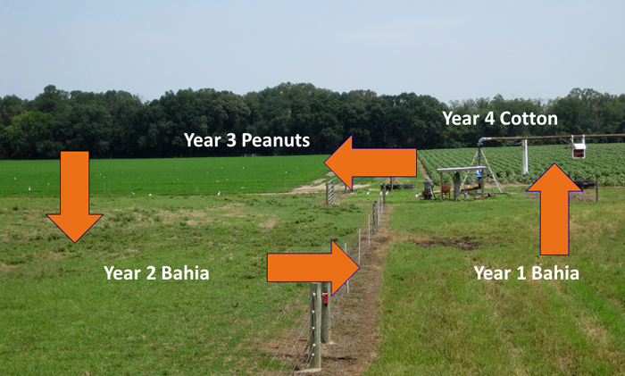
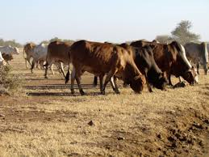
Using land- Agricultural
Crop rotation
Overgrazing

Slide 22
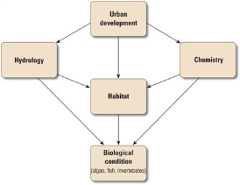
Urbanization- is the growth of urban areas caused by people moving into cities (Textbook pg. 209
Causes
Effects
Industrial revolution
Job opportunities
Emergence of large manufacturing centers
Availability of easy transportation
Urban Development Can Alter Stream Channels
Concentrations of Contaminants in Water Increase with Urban Development
Loss of Sensitive Species

Slide 23
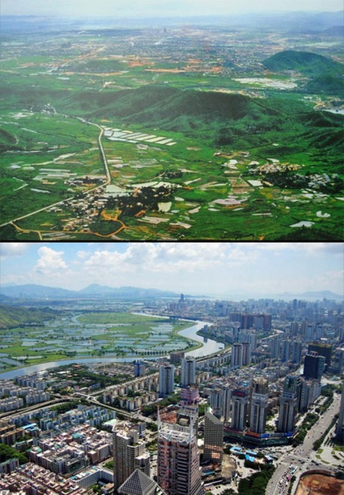
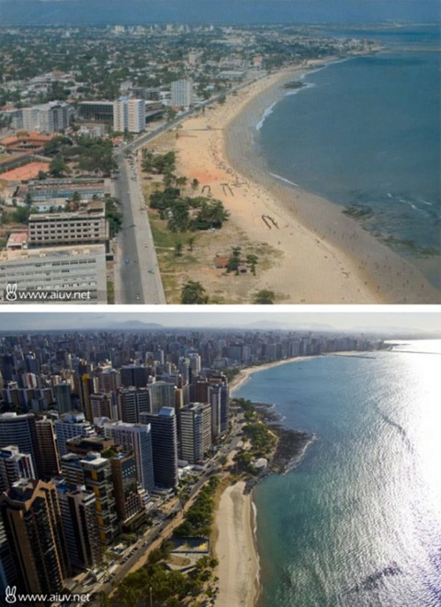

Slide 24
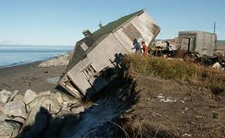
Erosion- is the wearing away of the land by forces such as water, wind, and ice
What causes erosion?
effects
Water is the main cause of erosion on Earth
Wind can erode by picking up and carrying loose particles and dust away
Glaciers are giant rivers of ice that slowly move carving out valleys and shaping mountains.
Poor soil quality
runoff can cause water pollution

