Slide 1
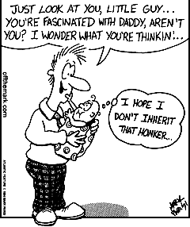
DNA Brainpop
(take handout!)
Day 10 Bell Work
Use 1 or 2 complete sentences to explain how the cartoon (at right) connects to offspring, traits, parents, or sex cells or “genetic info”
(USE YOUR PINKIE)
Today you will need pages 13-14
“honker” = large nose

Slide 2
What is Genetics?
p 13
23 chromosomes
from biological mom
& 23 from biological dad
heredity
You got it from
your parents
passed on
The study of how traits are inherited through the interactions of genes
black hair
or
blonde hair?
dangling earlobe
or
attached earlobe?
tongue curler
or
non-curler?
brown eyes
or
blue eyes?
hairy knuckle
or
smooth knuckle?

Slide 3
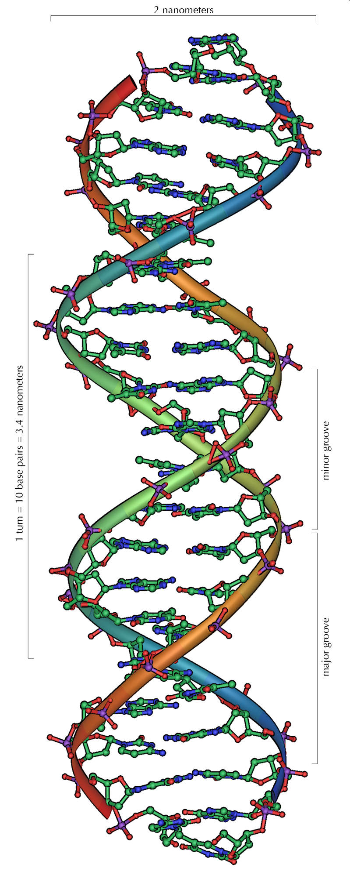
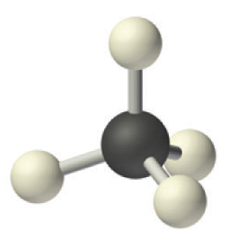
DNA is a molecule!
atom
atom
Molecule!
atom
atom
DNA is a very complex molecule
atom

Slide 4
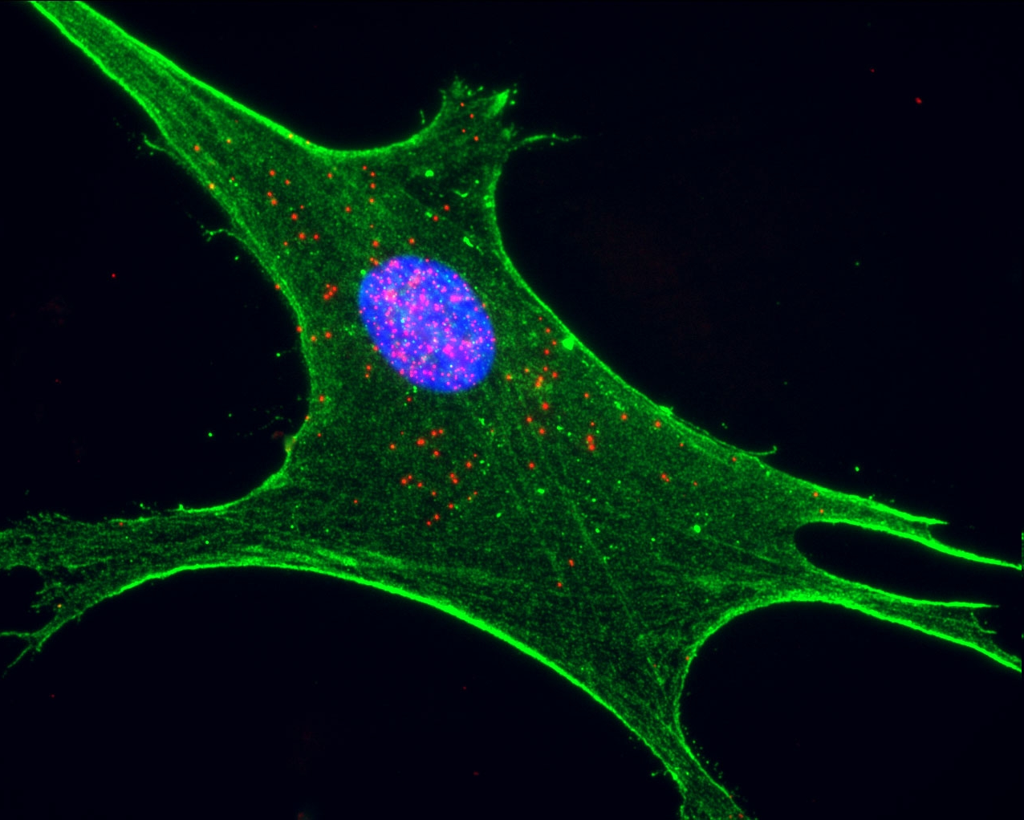
Nucleus

Slide 5
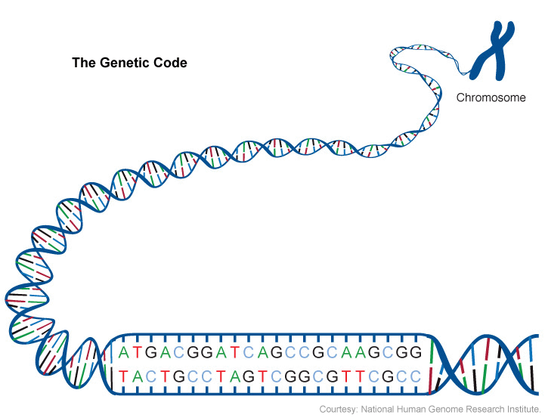
= DNA

Slide 6
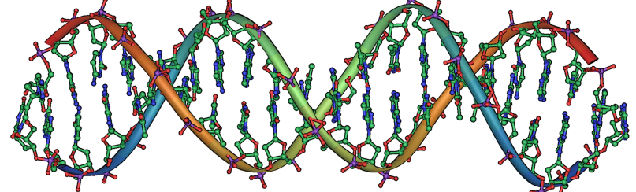
DNA
Contains instructions for the cell
Made of two strands twisted together in a double helix
99.9% of your DNA is identical to everyone else’s
The remaining 0.1% influences our differences (hair color, eye color, height, etc.)

Slide 7
Genes
DeoxyriboNucleic Acid
Short segments of DNA
One DNA molecule contains many genes
Each gene has instructions for a trait in an organism

Slide 8
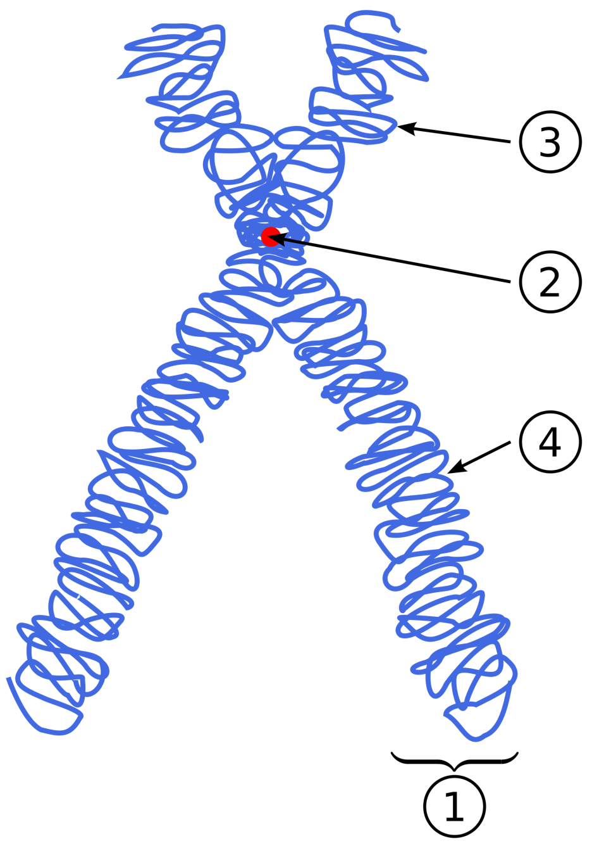
Chromosomes
Packets of coiled-up DNA
Humans have 46 chromosomes in our body cells (23 in our sex cells)
Each parent contributes half of his/her chromosomes to its offspring

Slide 9
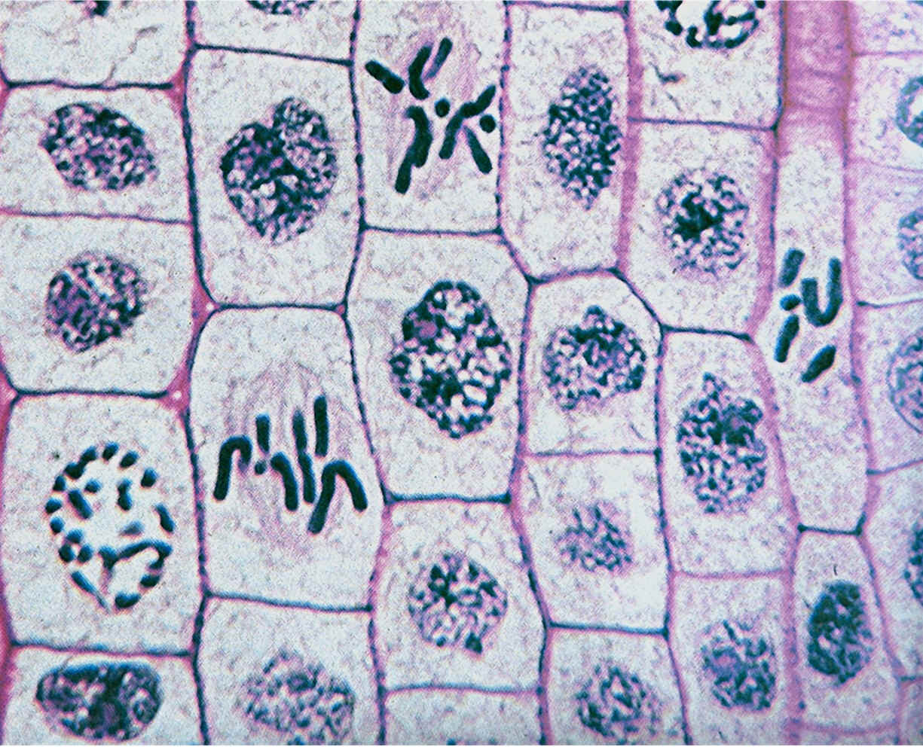

Slide 10
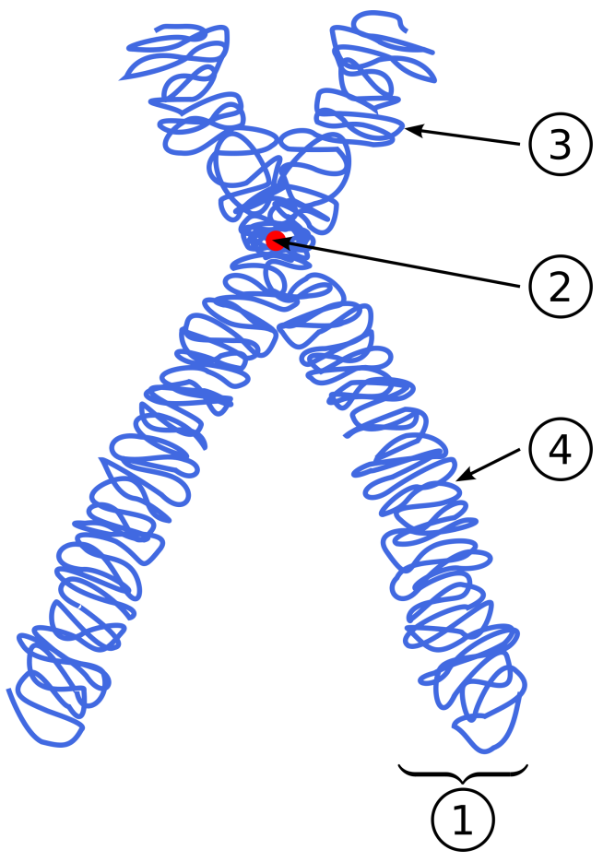
Diagrams you might see…
1 chromosome
1 chromosome
genes
chromosome pair
gene
gene
gene
gene
segments of DNA

Slide 11
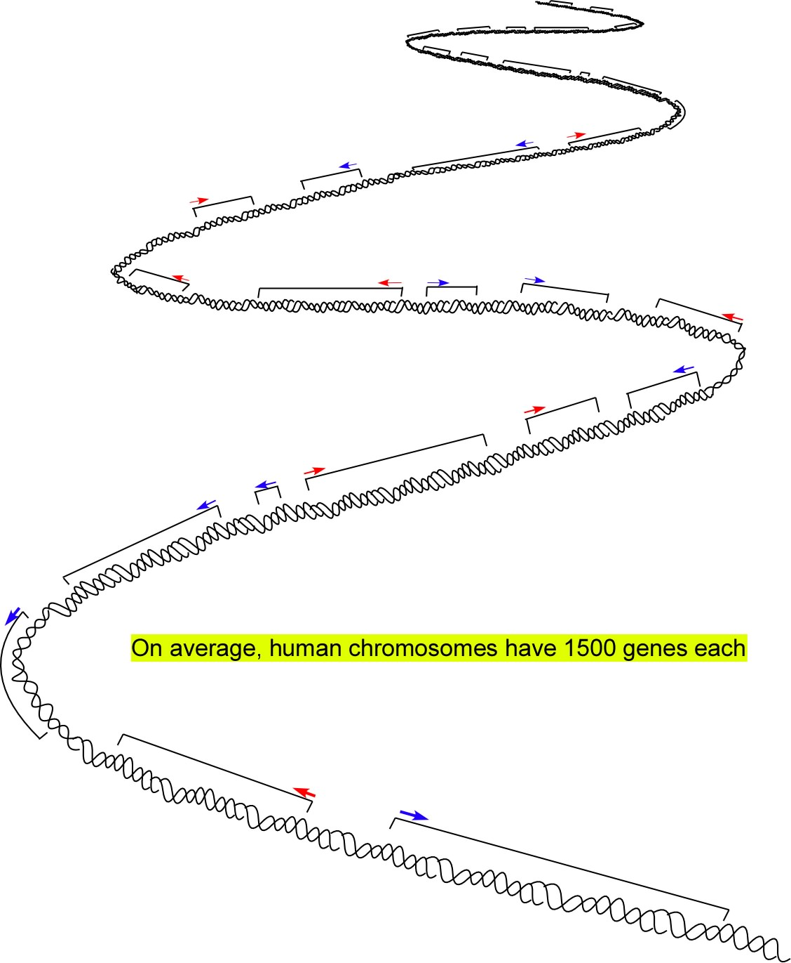
Diagrams you might see…
gene
gene
gene
gene
a different gene
another gene
a gene

Slide 12
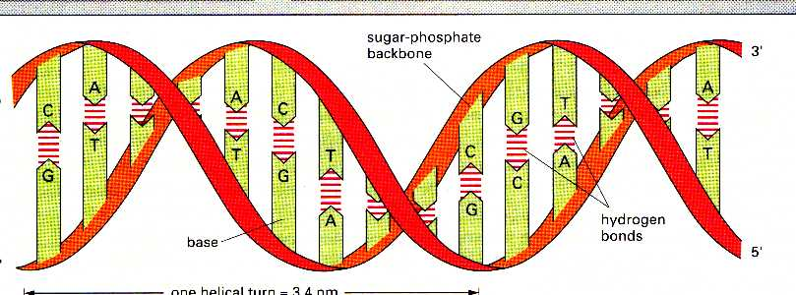
GENE
a segment of DNA (called a ________)
Nucleic acid
Nucleic acid
Nucleic acid
Nucleic acid
DNA is a molecule made of “nucleic acids”
DNA code (the order of those nucleic acids) gives instructions for putting together PROTEINS
DNA has a chemical pattern

Slide 13
pair

Slide 14
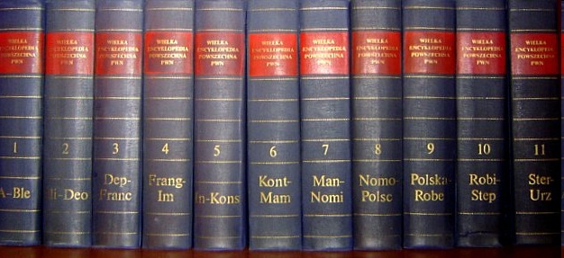
Chromosomes
are like books
(Humans have 46 chromosomes)
Table of Contents
Eye color
Blue
Brown
Green
Earlobe Shape
Attached
Hanging
Hair Color
Blonde
Black
Brown
Red
Genes are like the chapters in the books
(Humans have
Between 25,000 and 80,000 genes – research is still ongoing!)
The words and letters are like DNA.
(the code or language of genes)

Slide 15
3.
2.
1.
4.
5.

Slide 16
Heredity
The passing of traits from parents to offspring

Slide 17
Traits
Characteristics or features
Genetic traits are passed through the genes, from parents to offspring
Traits can be influenced by the environment
Ex: your hair may become lighter after being in the sun for long periods of time
Ex: you may have a gene for tallness, but due to malnourishment (not enough food), you might never reach your full height.

Slide 18
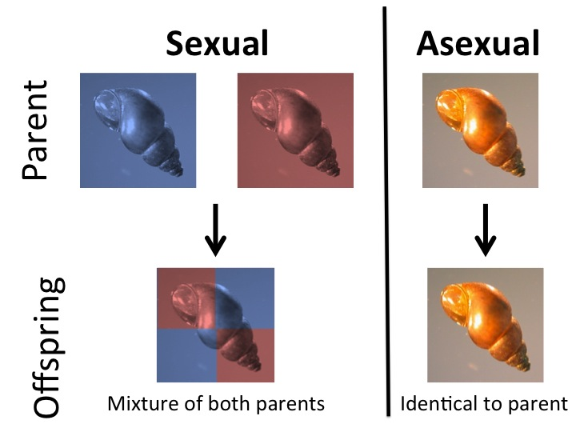

Slide 19
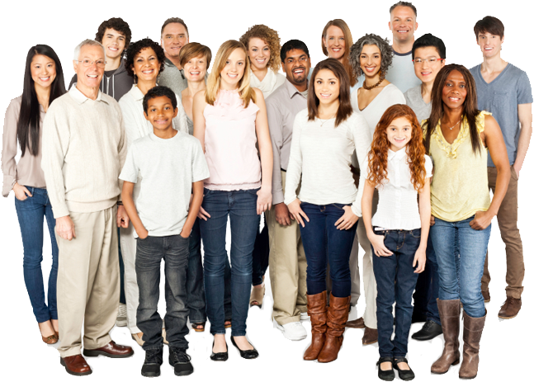
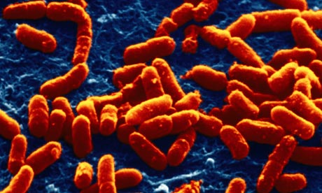
Yippee!
We were all formed by Sexual Reproduction!
organism = Human
Each of us
has a unique combination of traits!
We’re all genetically identical.
:(
We were all formed by Asexual Reproduction.
organism = Bacteria

Slide 20
Traits & Reproduction
ASEXUAL
SEXUAL
The offspring have the exact same traits as parent (same DNA)
Very little variation from generation to generation.
Offspring get a random half of DNA from each parent.
More variety! (New combinations of traits with each new generation.)

Slide 21
REALLY IMPORTANT facts to add at the bottom of page 13…
Every cell in an organism has ALL the DNA for ALL parts of that organism!
Example: A human skin cell has the DNA to make ALL the parts of a human being.

Slide 22
Page 14
DNA contains code for making PROTEINS!
WHY PROTEINS?
Everything in your body is partly or mostly made of proteins! (every cell!)
Cross out #4 – but leave the blank space!
DNA codes for making PROTEINS
Because you are made of proteins!

Slide 23
Yarn Model of DNA
1. Turn to page 14.
2. Click the link above to watch the video demonstration (if you are viewing these slides outside of class).
3. The video will lead you through getting the notes for page 14!

