Slide 1
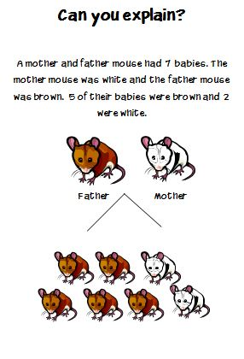

Slide 2
Which statement do you agree with most? Explain your thinking | Baby mice inherit more traits from their fathers than their mothers. | The baby mice got half their traits from their father and half from their mother. | Male traits are stronger than female traits.
Brown mice have more traits than white mice. | The brown baby mice are probably male and the white baby mice are probable female. | Parent’s traits like fur color don’t matter-nature decides what something will look like. | Blood type determines what traits babies will have.

Slide 3
Why do we look and act the way we do?
Learning Goal: I can Understand and explain that every organism requires a set of instructions that specifies its traits that this hereditary information (DNA) contains genes located in the chromosomes of each cell, and that heredity is the passage of these instructions from one generation to another.
Learning Target: I can explain what heredity is and give examples of inherited traits.

Slide 4
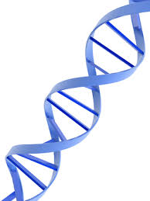
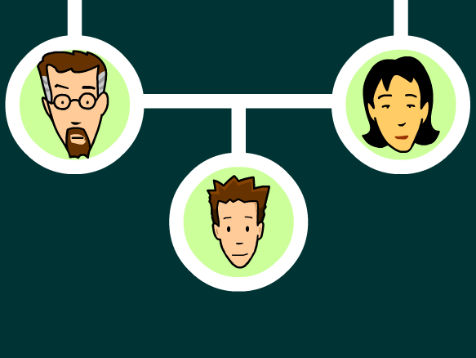
Genetics is the study of heredity.
Heredity is the passing on of characteristics from parent to offspring.
These characteristics are called traits.
Traits are physical characteristics of an organism
Example: eye color, height, hair color

Slide 5
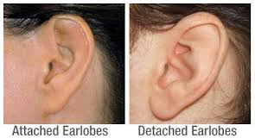
An Inventory of my traits:
1. I have detached Earlobes

Slide 6
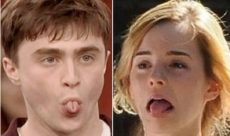
2. I can roll my tongue

Slide 7
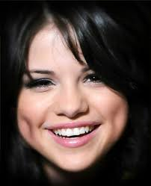
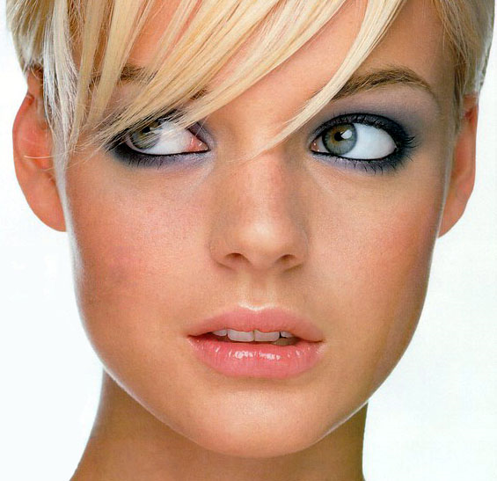
3. I have dimples

Slide 8
4. I am right-handed

Slide 9
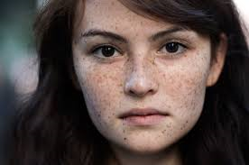
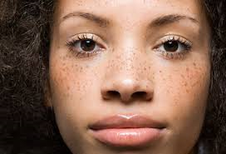
5. I have freckles

Slide 10
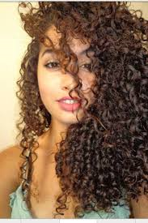
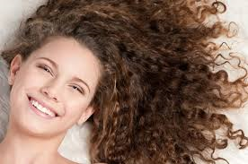
6. I have naturally curly hair

Slide 11
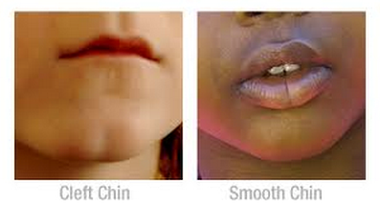
7. I have a cleft chin

Slide 12
8. I cross my left thumb over my right when I clasp my hands together

Slide 13
9. The hairline on my forehead is straight

Slide 15
Review- Did we hit our target?
The passing of traits from parents to offspring is called:
a. Hand me downs c. purebred
b. Heredity d. Hybrid

Slide 16
Genes determine the characteristics or ___________ each offspring will have.
a. Cells c. traits
b. Nuclei d. chromosomes

Slide 17
Give another example of a trait (not from our list)

