Slide 1
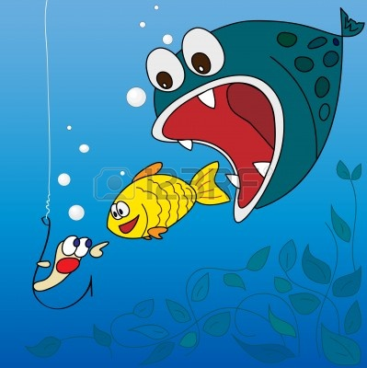
Diversity of Living Things

Slide 2
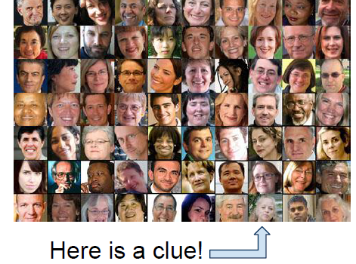
Evolution
Considered a UNIFYING THEORY OF BIOLOGY, because it helps us explain and understand the DIVERSITY of life on the planet.
In your own words: define diversity.

Slide 3
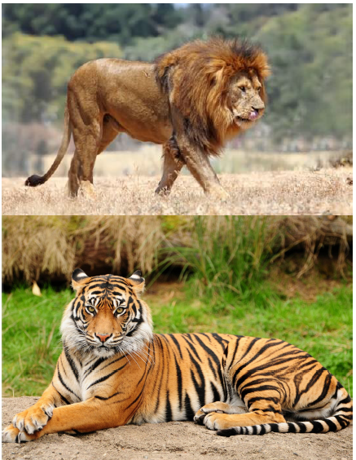
Consider this……..
Lions live in Africa
Tigers live in India
How are they similar?
How are they different?

Slide 4
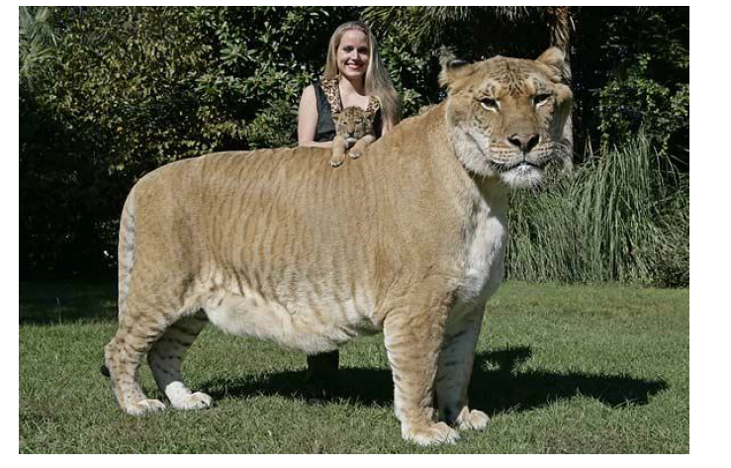
What happens if Lions and Tigers mated?
They make ligers……………..
How can evolution
explain this?

Slide 5
What is a scientific theory?
Statements or models that have been tested and confirmed many times
They explain a wide variety of data and observations
They can be used to make predictions
They are not absolute, can be changed as new evidence is found

Slide 6
History of Evolution
Charles Darwin developed the theory of Evolution by Natural Selection
Which explained how organisms changed (adapted) over time
Lamarke’s Theory of Acquired Characteristics
Stated that you would gain or lose features if you overused or didn’t use them at all.
Which is correct?
Darwin

Slide 7
Checkpoint
What theory did Darwin develop?
This theory explained how organisms ______________ over __________.

Slide 8
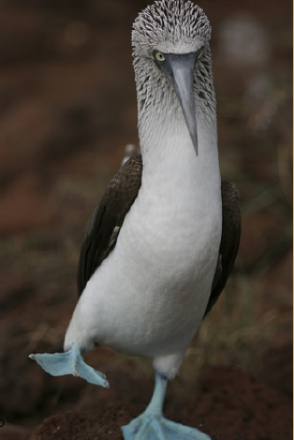
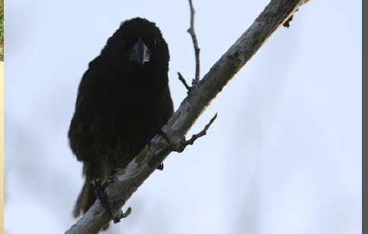
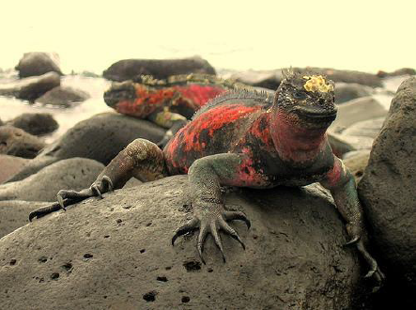
Darwin Studied on the Galapagos Island
Blue Footed Bobby
Found unique species like:
Finches
Marine Iguana

Slide 9
Key Points
Variation: exists among individuals within a species
Individuals will compete for resources
Competition would lead to death for some, while others would survive
Individuals that had advantageous (beneficial) variations are more likely to survive and reproduce

Slide 10
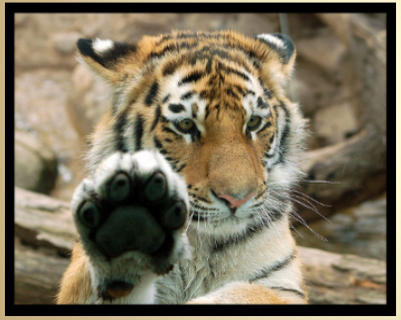
Process…
What Darwin observed happening on the Galapagos Islands became known as the process of Natural Selection
Favorable variations are called Adaptations
What adaptations do tigers have?
Humans?
Snakes?

Slide 11
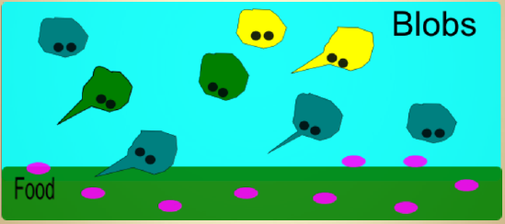
An analogy…
A species of blob…there exists blobs of all shapes sizes (variation)
Blob eat little purple organisms that live underground and on the surface

Slide 12
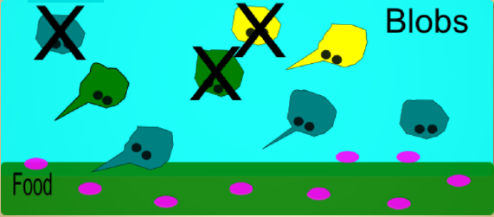
During a particularly hot year, food became less abundant (competition), blobs that had the ability to dig into the soil to get food had a better chance of survival

Slide 13
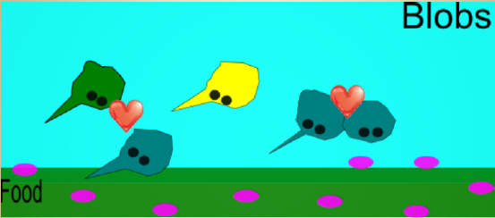
The ones that survived mated and passed their genes to the next generation(reproduction)

Slide 14
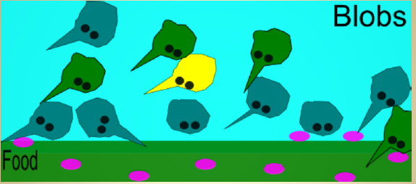
The next generation had move blobs with the pointed noses. That is NATURAL SELECTION.
Variation
Competition
Survival
Reproduction

Slide 15
Checkpoint
The theory states
Individuals of a species have difference, called ___________________
These individuals ______________for resources
Some will die, others will _________________ and pass traits to offspring
Any trait that helps an organism survive is called an ________________

Slide 16
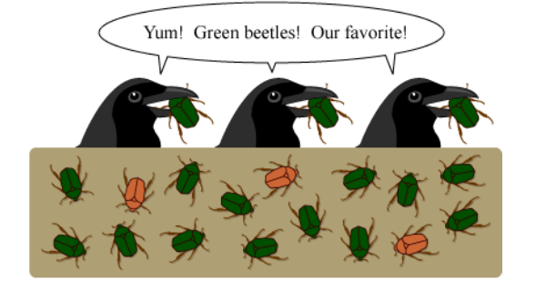
Natural Selection, in a nutshell
In 1-2 sentences, explain this image

Slide 17
Theory of Evolution -- Evidence
Fossils-similarities between extinct animals & animals that are alive today
The deeper we dig the farther back in time we see
Homologous Structures- parts of the body that are similar, but have different functions
All forelimbs of vertebrates have common patterns, shows common ancestor
Vestigial Organs- organs or parts that seem to have no function
DNA- similar in species that are more closely related
Embryological Development- different species develop in almost identical ways

Slide 18
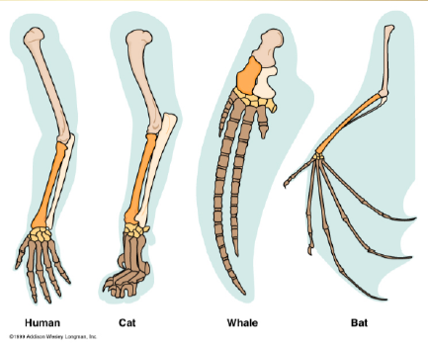
Homologous Structures

Slide 19
Vestigial Structures

Slide 20
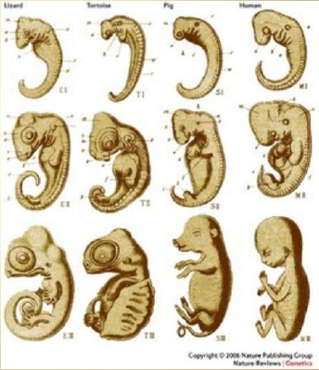
Embryological Development

Slide 21
Checkpoint
_____________ evidence shows when organisms lived on earth.
Species that are closely related will have similar ____________
A _____________ organ is one that has no function
________________ structures look the same but have different functions
________________ of different animals develop in the same way

