Slide 1


Welcome to 7th grade Science
Mrs. Georgakakis

Slide 2
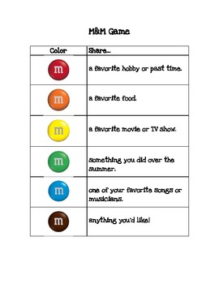

Slide 4
Absent?
Go to Mrs. G’s Website
Tsmsmrsg.weebly.com

Slide 5

Fusion Textbook
Thinkcentral.pcsb.org
7th grade science timeline
Nature of Science
Unit 1 Let’s Rock/Human Impact
Unit 2 Hot Plates
Unit 3 It’s About Time
Unit 4 Heredity and Reproduction
Unit 5 Diversity and Evolution of Living Things
Unit 6 Ecology
Unit 7 Catch a Wave
Unit 8 Here Comes the Sun’s energy
Unit 9 Feel the Heat
Unit 10 Transformers

Slide 6


Cambridge-Fusion Textbook
Unit 1 Lets Rock/Human Impact
Unit 2 Hot Plates
Unit 3 It’s About Time
Unit 4 ‘Round and ‘Round They Go!
Unit 5 Star Light, Star Bright
Unit 6 How Do We Compare?
Unit 7 It’s Astronomical
Unit 8 Heredity and Reproduction
Unit 9 Diversity and Evolution of Living Things
Unit 10 Ecology
Unit 11 Matter and Energy in Living Systems
Unit 12 Conservation is the Law
Unit 13 Catch a Wave/Here Comes the Sun’s Energy
Unit 14 Feel the Heat/Transformers

Slide 7
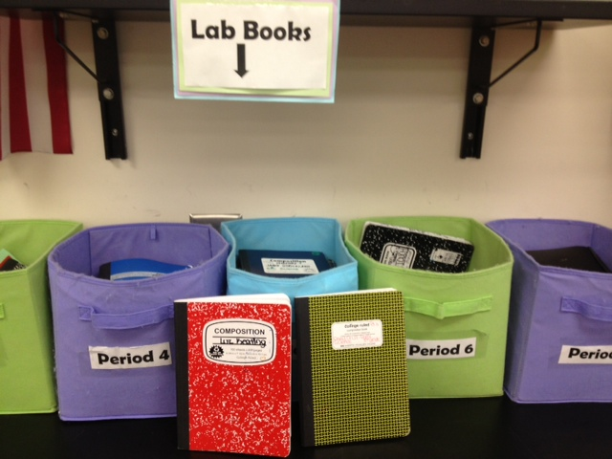
What do you need for Science class?
To be successful, each student will need:
a science composition book (dedicated ONLY to science)
colored pencils
glue stick
colored pens
notebook paper
hand held pencil sharpener
and a simple set of headphones

Slide 8
Entering the Classroom
  Enter the classroom before the bell rings
  Take your seat and get out the materials you need for class
Update planner – Homework or Learning Target
Copy and Answer Warm Up
Update Table of Contents

Slide 9

Tardy
Any students who is not in the classroom when the bell rings will be considered tardy.

Slide 10

End of class
At the end of class, please remain in your seat. We do NOT line up at the door.
I will dismiss you not the bell!

Slide 11
Listening To/Responding To Questions:
Everyone has the right to be respected when they are speaking. If you would like to ask a question or make a comment, please raise your hand and wait to be called on. Please do not speak while someone else is speaking. Everyone will have an opportunity to talk.
What sound does a waterfall make?..... When I say waterfall….SHHHHHHHHHH

Slide 12

When You Need Help:
If you are having difficulty with an assignment, I am available before school. Please arrange a time with me and I am happy to help you.

Slide 13

Restroom Passes:
You will receive a bathroom pass each quarter with 8 passes (boxes). You must have your pass to use the restroom. Any boxes remaining will earn you extra credit at the end of the grading period. You MAY NOT request restroom passes during direct teacher instruction there will be NO EXCEPTIONS to this. You must be present to benefit from the teaching happening in class.

Slide 14

Classroom Language:
Please use appropriate language in the classroom. Do not use negative words and speak positively about other classmates and what we are studying

Slide 15

When You Finish Early:
If you finish your work early, read your book or work on other work that you need to finish.

Slide 16
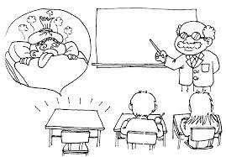
Absent?
Go to: tsmsmrsg.weebly.com
It is your RESPONSIBILITY to find out what you missed if you were absent. You have 1 day for each absent to make up your work for FULL credit, after that, late paper policy will take effect.

Slide 17
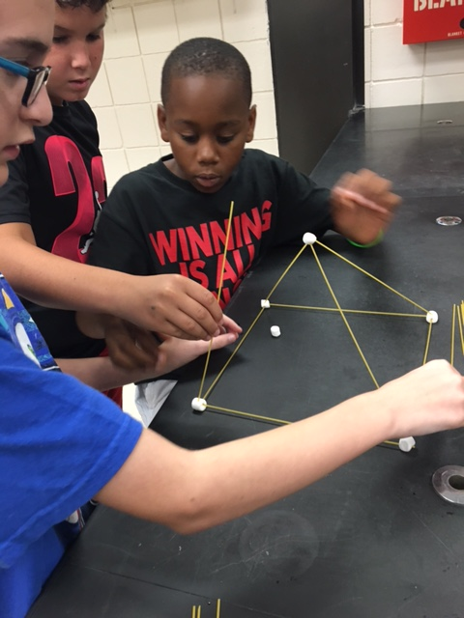
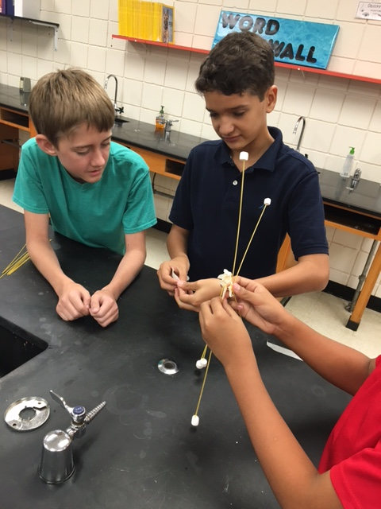
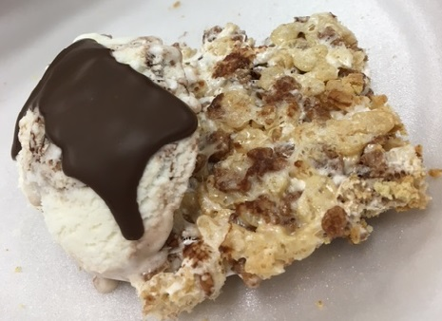
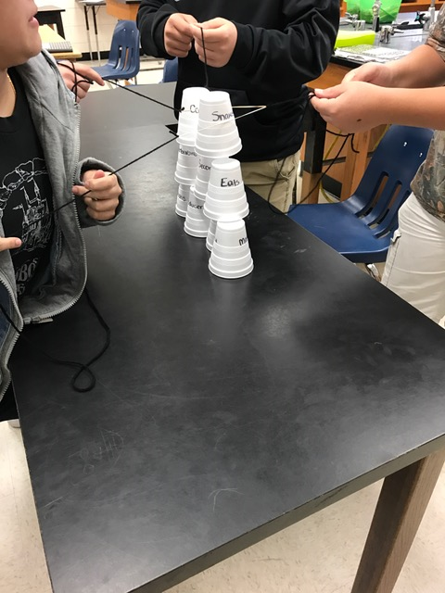
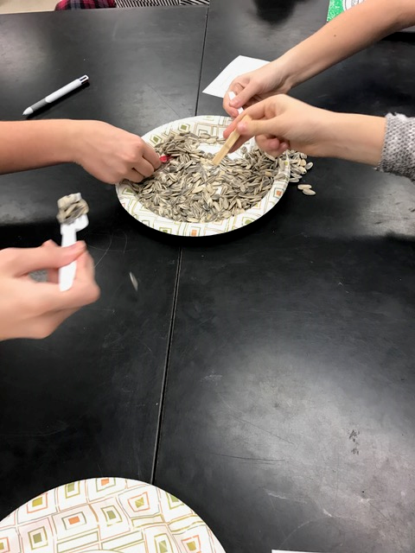

Slide 18
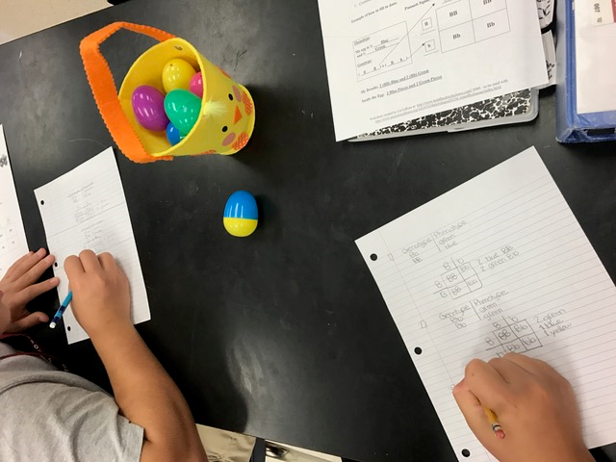
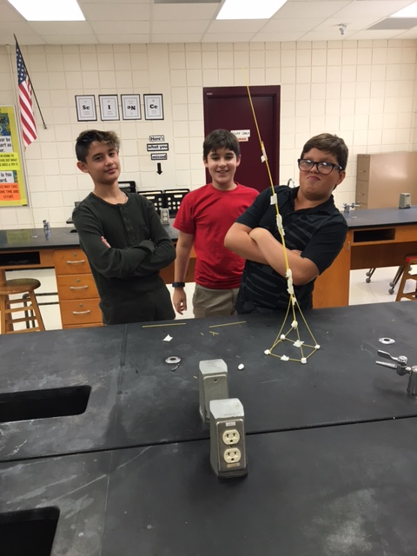
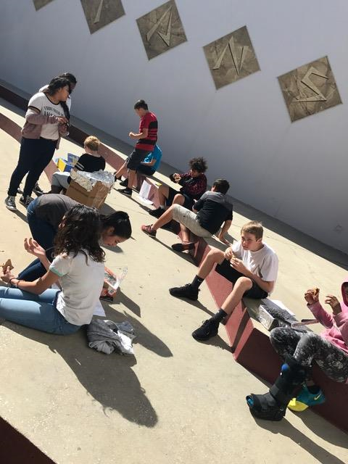
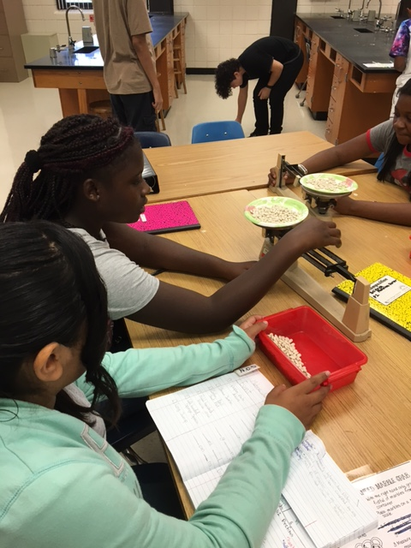
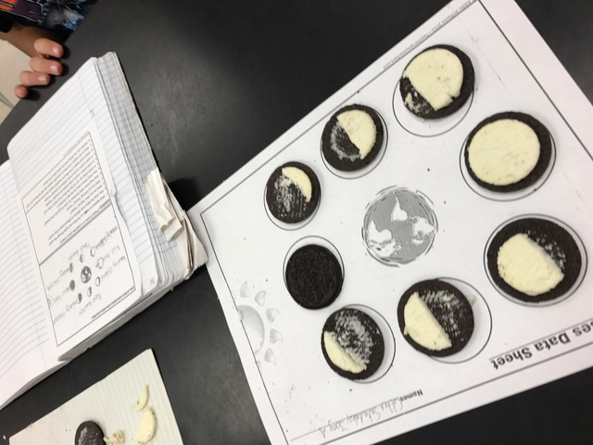

Slide 19
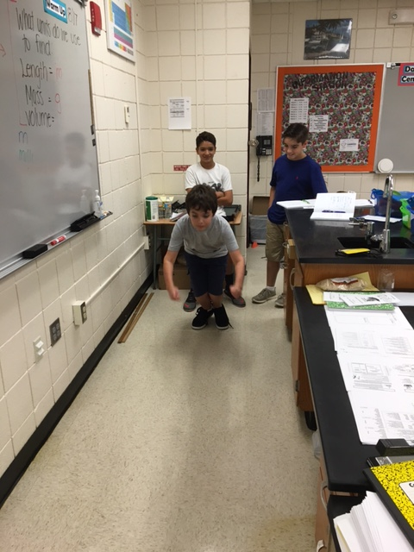
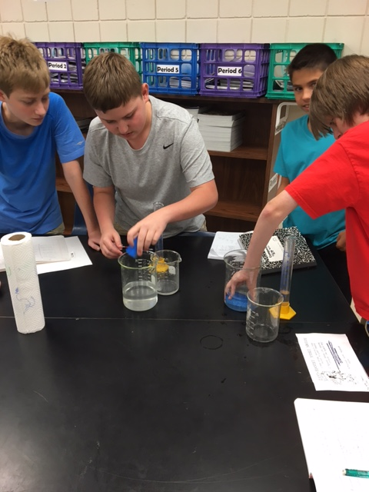
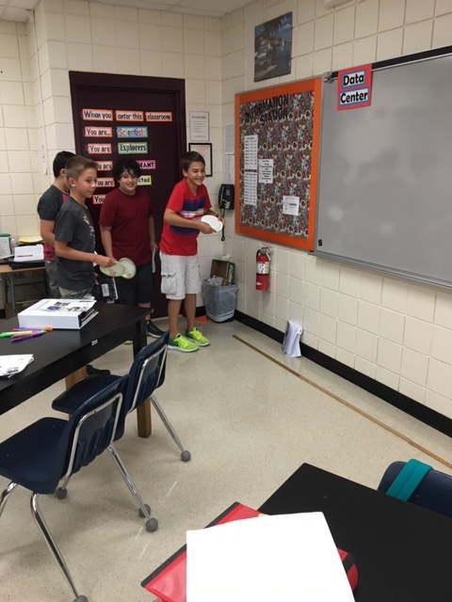

Slide 20
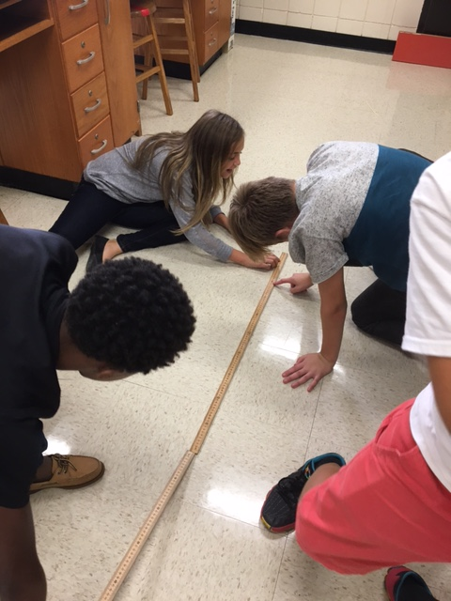
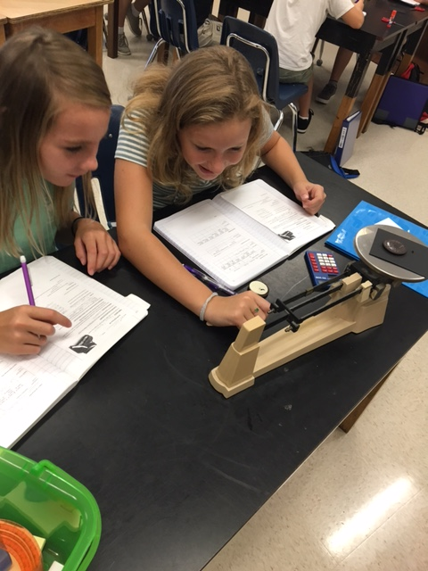
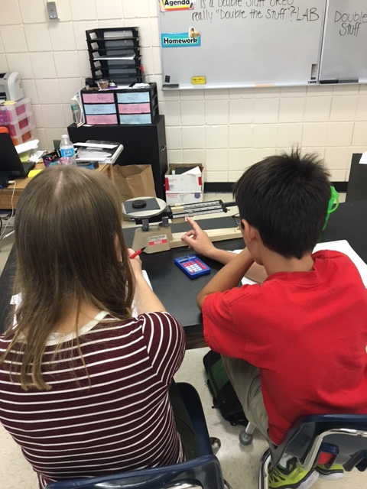

Slide 21
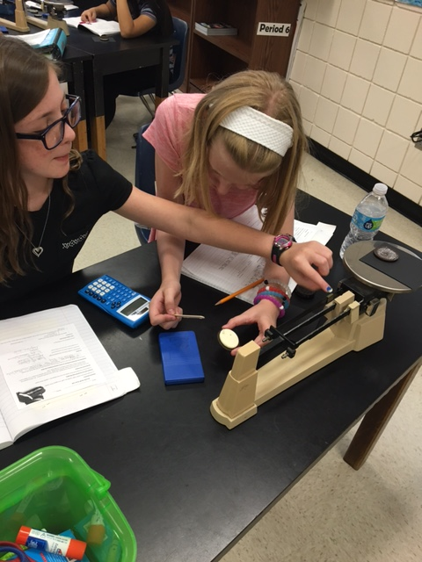
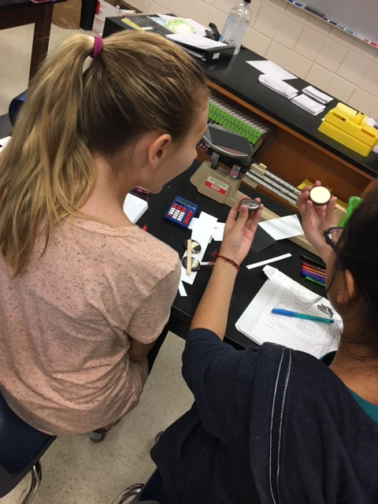
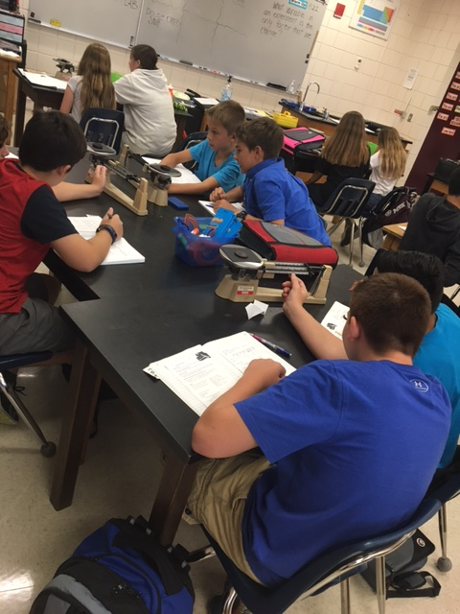

Slide 22
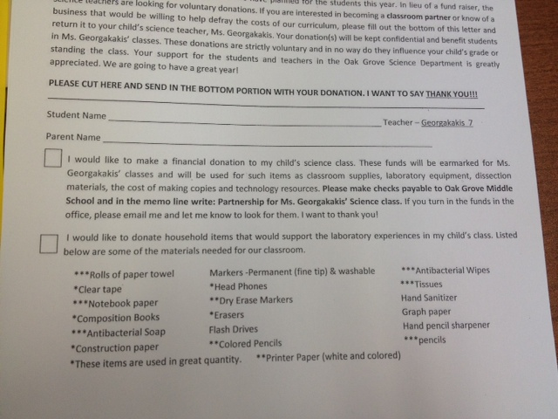
Class Donations

Slide 24
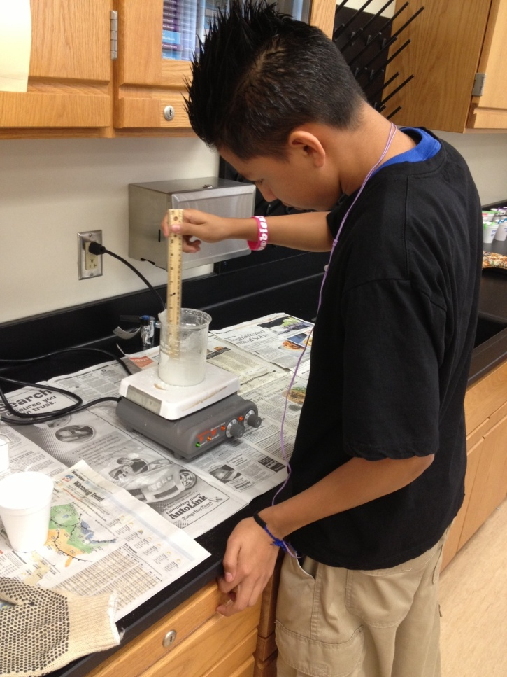
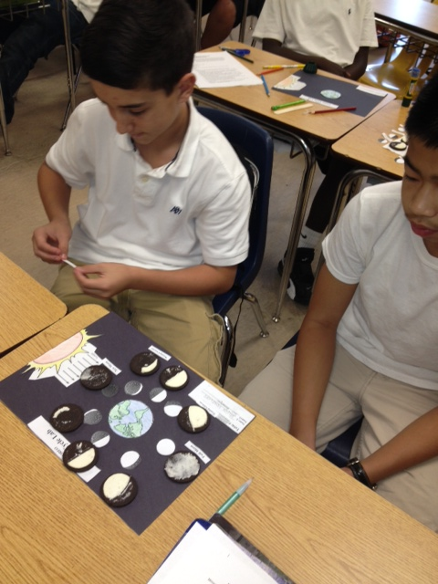
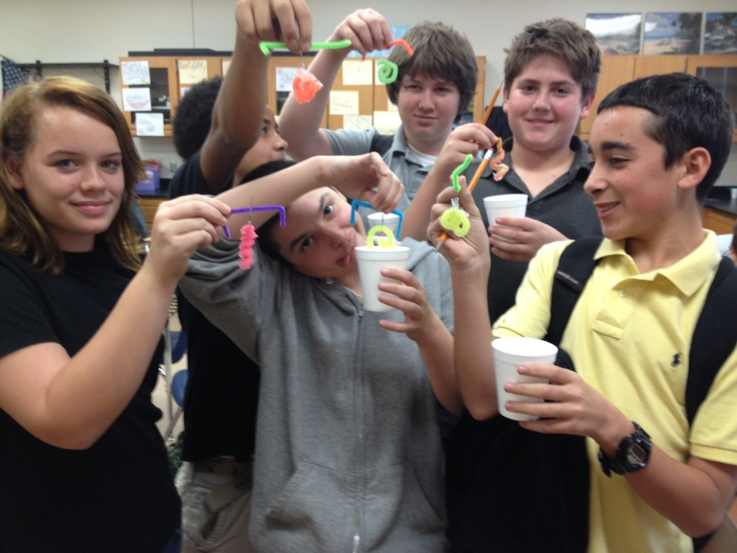
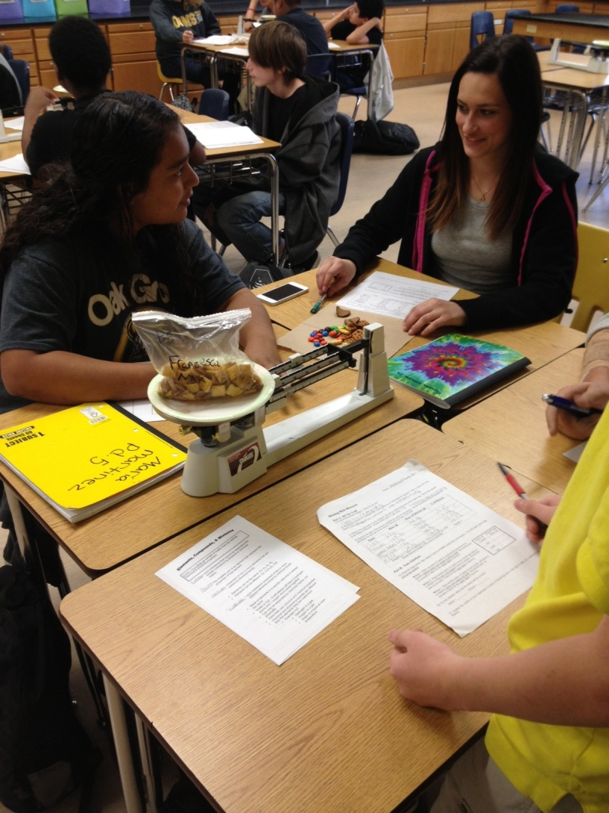
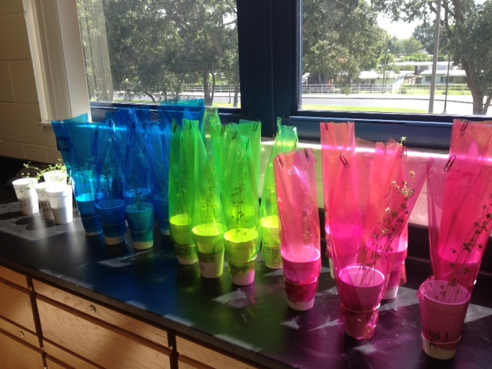
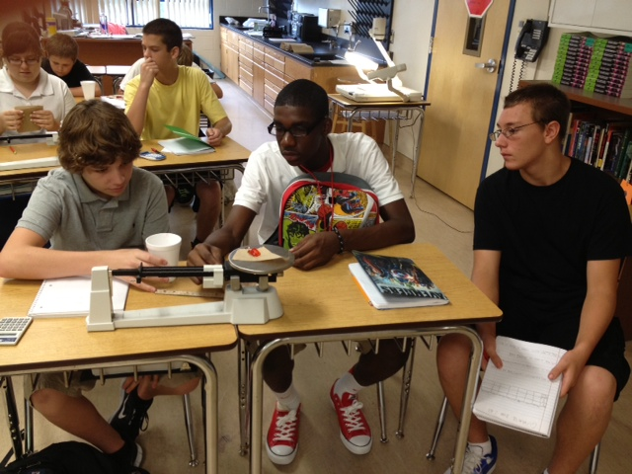
Labs

