Slide 1
What is a wave?
SC.7.P.10.3 Recognize that light waves, sound waves, and other waves move at different speeds in different material
Unit 5 lesson 1

Slide 2
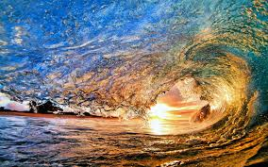
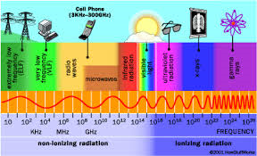
What are waves?
A wave is a traveling disturbance that travels through space and matter transferring energy from one place to another.

Slide 3
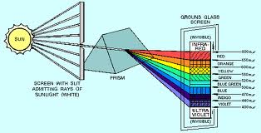
Waves in Everyday life
Sound moves through matter and vibrates our ear drums so we can hear.
Light is a special kind of wave made of photons that help us see.
You can drop a rock into a pond and see waves form.

Slide 4
Types of waves
All waves can be categorized as either mechanical or electromagnetic
Mechanical waves- require a medium. This means that they have to have some sort of matter to travel through. One example is sound. Sound can travel through air, water, or solids, but it cant travel through a vacuum. It needs the medium to help it travel.
Electromagnetic waves- are waves that can travel through a vacuum (empty space). They do not need a medium or matter. They travel through electrical and magnetic fields that are generated by charged particles.

Slide 5
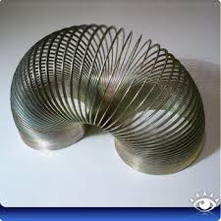
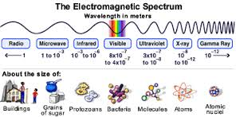
Types of waves
Mechanical Waves examples: water waves, seismic waves, and waves traveling through a spring
Electromagnetic waves examples: light, microwaves, radio waves, and x-rays

Slide 6
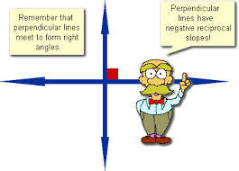
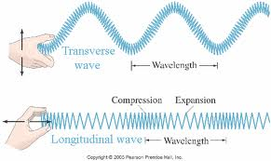
How does a wave transfer energy?
Transverse waves- are waves where the disturbance moves perpendicular to the direction of the wave. One example is a water wave where water moves up and down as the wave passes through the ocean.
Longitudinal waves- are waves where the disturbance moves in the same direction as the wave. One example of this is a wave moving through a stretched out slinky or spring

